Slide 1
Serious Games and AI
Python Intro – OpenAI Gym
Summer 2021
Notes:
1
1
Check distro statement before using:
DISTRIBUTION STATEMENT A. Approved for pubic release: distribution is unlimited.
This material is based upon work supported under Air Force Contract No. FA8721-05-C-0002 and/or FA8702-15-D-0001. Any opinions, findings, conclusions or recommendations expressed in this material are those of the author(s) and do not necessarily reflect the views of the U.S. Air Force.
© 2021 Massachusetts Institute of Technology.
Delivered to the U.S. Government with Unlimited Rights, as defined in DFARS Part 252.227-7013 or 7014 (Feb 2014). Notwithstanding any copyright notice, U.S. Government rights in this work are defined by DFARS 252.227-7013 or DFARS 252.227-7014 as detailed above. Use of this work other than as specifically authorized by the U.S. Government may violate any copyrights that exist in this work.

Slide 2
Overview
What is OpenAI Gym
Basic API
Basic Datatypes
Environments
Data Logging
Notes:
https://katefvision.github.io/10703_openai_gym_recitation.pdf

Slide 3
What is OpenAI Gym
A standard Python API for RL environments
Often cast as games
Can run many RL algorithms against the same environment
A set of tools to measure agent performance
Built in tools are very helpful
An online scoreboard for comparing and benchmarking approaches
Meant to provide a set of stable environments for testing RL algorithms
We use it to build our own environments and use well proven RL algorithms
https://gym.openai.com/
Notes:
https://katefvision.github.io/10703_openai_gym_recitation.pdf

Slide 4
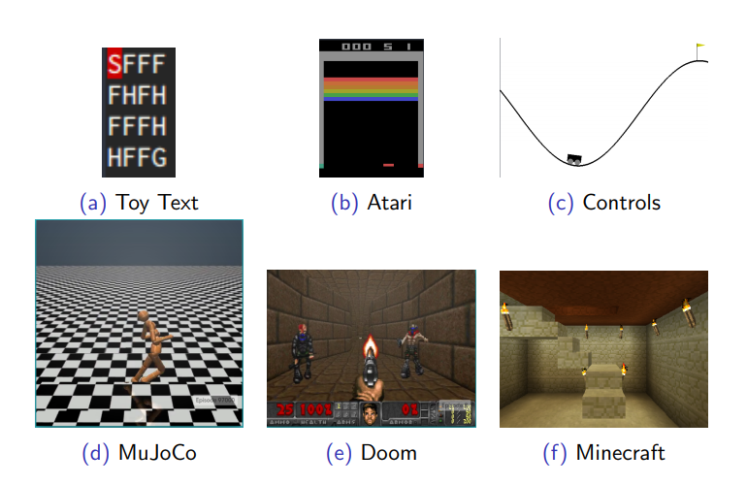
Examples
Notes:
https://katefvision.github.io/10703_openai_gym_recitation.pdf

Slide 5
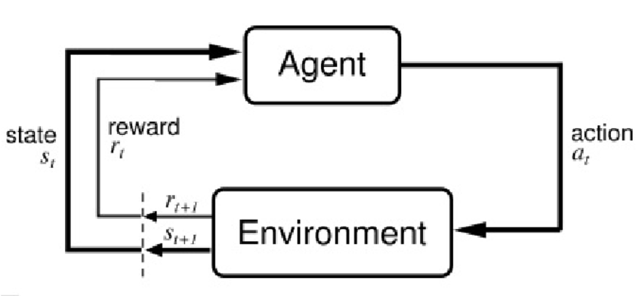
Reinforcement Learning
RL as a decision making process:
Environment: Model that allows agents to take actions and provides state and reward signals
State: The environment’s current situation
Actions: What the agent is allowed to do within the environment
Reward: Incentive or penalty associated with taking an action within an environment
Policy: Mapping from past experience to action
Notes:
https://en.wikipedia.org/wiki/Reinforcement_learning

Slide 6
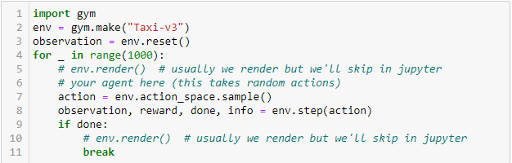
Basic API
Notes:
https://katefvision.github.io/10703_openai_gym_recitation.pdf

Slide 7
Basic API
Naming
Unique name of the form ([A-Za-z0-9]+-)v([0-9]+)
Reset Function
Reinitialize a new gameplay (episode)
Resets state to initial state
Step Function
Takes in actions
Returns updated state, reward, done status, and debug info
Main game logic is usually executed within this function
Render Function
Technically optional
Displays state information
Notes:
https://katefvision.github.io/10703_openai_gym_recitation.pdf

Slide 8
Basic Datatypes
Reward -> float
Done / Terminal -> Boolean
States
Custom OpenAI Gym datatypes
Discrete and continuous
Pretty flexible
Dependent on environment
Attributes “action_space” and “observation_space”
Includes convenience methods such as “sample”
Notes:
https://katefvision.github.io/10703_openai_gym_recitation.pdf

Slide 9
Basic States
Discrete
Contains n distinct points
E.g. [0, 1, … n] for n unique actions (convert actions to ints, enums)
MultiDiscrete
Contains k dimensions, each with separate discrete points
E.g. k=2 [(m, n), (p, q)] (2 dims, 1st ints from m to n, 2nd ints from p to q)
Box
Multidimensional continuous with bounds
Similar to MultiDiscrete but allows for continuous values
Tuple
Limited use, combines simple spaces, like 2 discrete spaces
Notes:
https://katefvision.github.io/10703_openai_gym_recitation.pdf

Slide 10
Environments
All custom environments must inherit from gym.Env
Must construct and model the action and state spaces
Overrides
Step (required)
Reset (required)
Seed
Render
Configure
Close
Registration
We will not cover this as part of the course
https://stable-baselines.readthedocs.io/en/master/guide/custom_env.html
Notes:
https://katefvision.github.io/10703_openai_gym_recitation.pdf

Slide 11
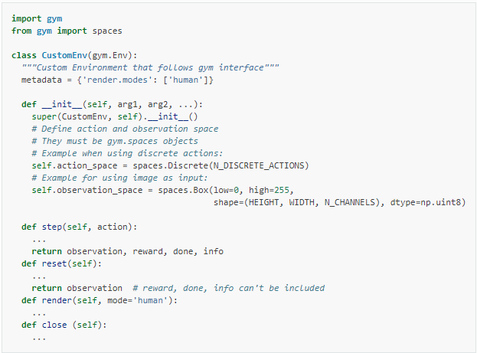
Environments
Notes:
https://katefvision.github.io/10703_openai_gym_recitation.pdf

Slide 12
Data Logging
Plan ahead!
Data Logging
Separate from debug logging, which should also be implemented
Know what you want to capture
Every step
End of episode
Training vs Playback
Use the Info variable that step returns to localize data logging
Many options
Store and save
Write to disk (during or after or both)
Database connections (Mongo, MySQL, etc…)
Notes:
https://katefvision.github.io/10703_openai_gym_recitation.pdf

Slide 13


